Slide 1
Housekeeping
Today:
Similar to last time, walk through SQL exercise from SAM (sql_sam_exercise files on Moodle.)
We’ll walk through the exercise and try to answer by writing SQL.
Similar-ish to the last module of Access stuff in SAM.
Ideally what we write by hand here should relate to the queries we’ve done.
As we go, ask if something doesn’t make sense.
If you can do this stuff, and it mostly makes sense in your head, you’re good wrt the requirements.
Next time:
Data, database, sql, Access question time – no new stuff, but if you have Qs please bring.

Slide 2
SQL Basics

Slide 3
Structured Query Language
When we want to interact with the data in a database we do so through a query.
This is effectively a question to the database – can you do this for me?
Query tells database what we want to see or do.
Database checks to make sure we are allowed to, and that it won’t break anything, then does it for us.
The queries that we make with the GUI tool generate SQL code to do the work.
We can look at, edit, or write the SQL code on our own.
SQL is genuinely a resume-boosting point for most people.
Many accountants, marketers, finance people, etc have to use data more and more.

Slide 4
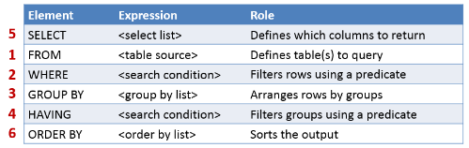
Query Parts
Queries have several sections, each providing a different part of the selection.
The first 3 are what we normally use:
What to get, from where, and what to filter.
The others are for grouping and aggregation.
I.e. getting one result per group.
After the first two, the rest are optional.

Slide 5

Query Joins
Joins can be specified in the FROM clause.
The syntax is:
Left_table TYPE_OF_JOIN right_table ON left_table.value – right_table.value
The joint type can be INNER JOIN, LEFT JOIN, or RIGHT JOIN.
The table_name.attribute name is used to differentiate which value we are talking about.

Slide 6
Other Query Types
The other types of queries work in a similar way.
Insert, update, delete, etc…
Each of these changes the SELECT (and maybe FROM) part into something else…
INSERT INTO…
DELETE FROM…
The idea is identical – provide the criteria for what we want, only here we are deleting/updating it instead of just seeing it.

Slide 7
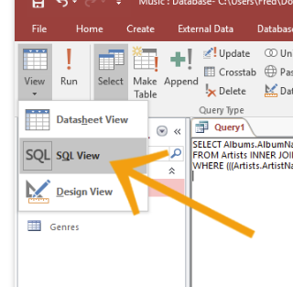
Using the Design View
When making a query, all the views will work.
If struggling, we can make one change then check it.
We can also see what each change looks like in the design/sql view, then adjust.
When working on something complex, we may need to edit SQL manually. (Unlikely for us)
If we have multiple steps, we can make a query and use it as input for another query.
Only requires us to do one step per query.

